Slide 1
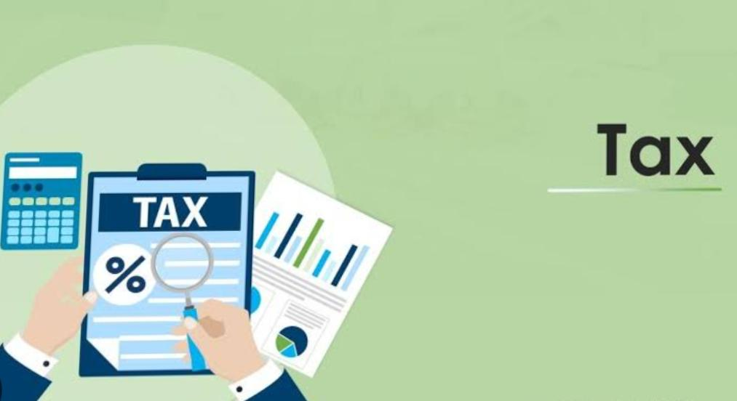
Tax and types of taxes

Slide 2
Good morning/afternoon Friends today I and my friends are going to present the PBL on topic “Tax and type of taxes”.

Slide 3
Do you all know that the government Hospitals, government parks, government schools, government schemes are established and maintained by the tax given by the citizens of our country.
The salaries of the Government servants are also given by the tax.Not only that but it is required for the various schemes and Public services provided to us by the goernment .

Slide 4
There are two types of taxes paid by the citizens
Direct tax
Indirect tax

Slide 5
The direct tax is tax which is paid for directly by the tax payers.For example Income tax, weath tax, professional tax etc
The income taxes is the one of the most important type of direct tax. This income tax is levied when the income earned by individual institute of authorized industry exceeds their limit under the income tax act.Every year the financial minister presents there budget for the next financial year. Which also includes the proposal of income tax rates.

Slide 6
Under the income tax act which came on 1st of April and the act passed every year by the parliament which makes financial provisions, the income tax of India is levied
As we know income tax is tax levied on income it is necessary to know about the types of income .
There are 5 types of income:income from salary, income from house/property , income from Business or profession, income from capital gain and income from other sources.

Slide 7
While computing the income tax , the annual income of employee is taken into consideration according to the sections of 80C,80D and 80G etc. in the income tax act the deductions are made from the total annual income. The income tax is levied on this taxable income. Every year the rules for computing this income tax are changed.

Slide 8
The second type of tax is indirect tax. These taxes are not paid directly by the tax payers.
For example: Central sales tax, value added tax, service tax, excise duty, customs duty etc.
The taxes which are present in the bills of movie theatre, malls, restaurants, hotels, buying a new car are the indirect taxes taken by us.

Slide 9
The end Thank you

